Slide 1
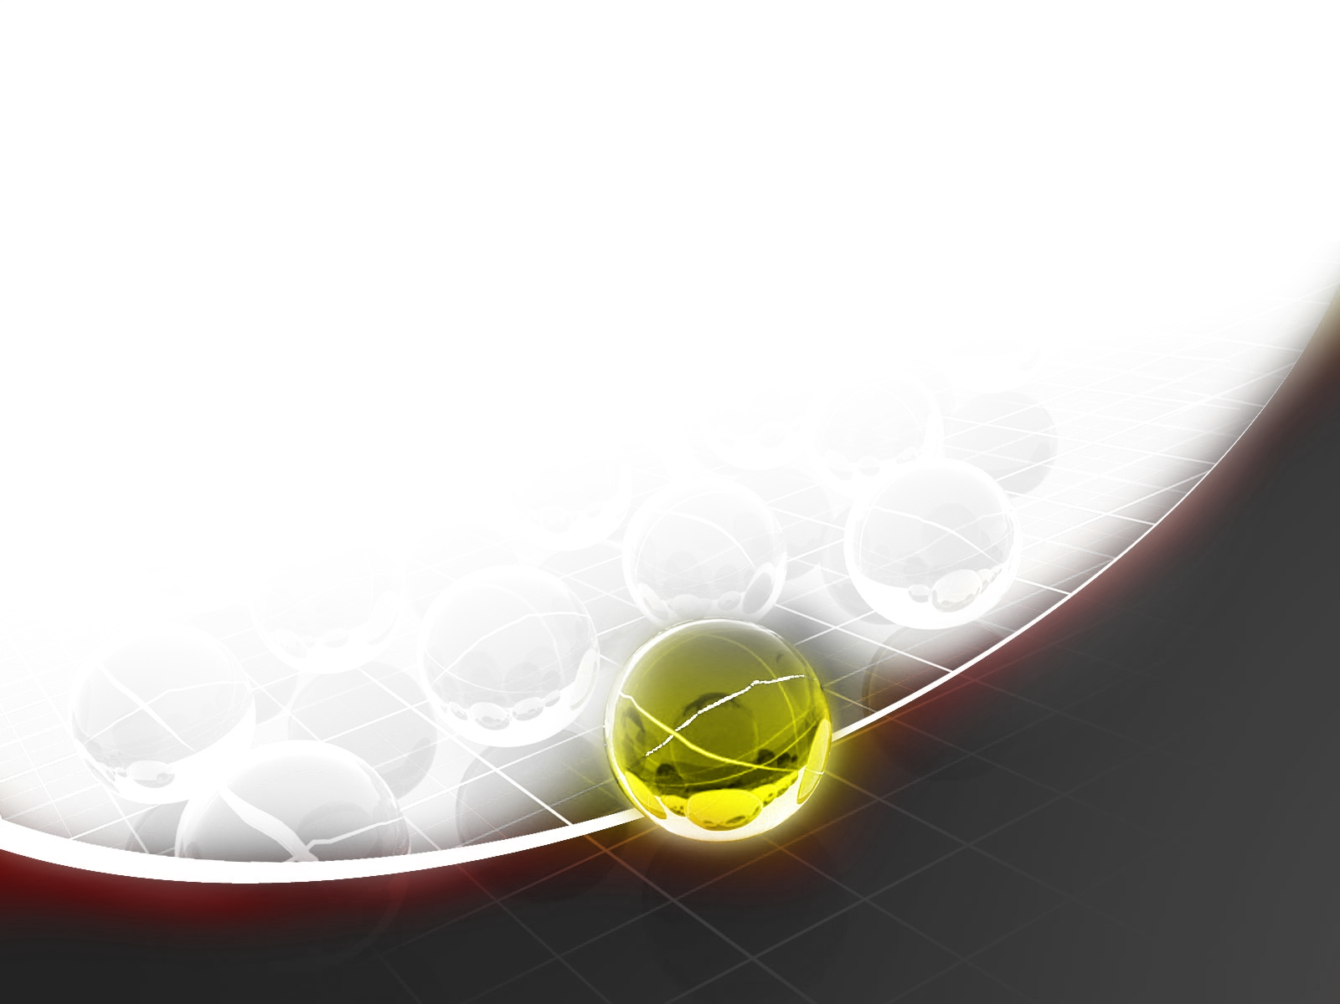
Causality Inference in a nonstationary and nonhomogenous framework (PASC Exploratory Project)
Patrick Gagliardini^{USI}
Illia Horenko^{USI}
Lukáš Pospíšil^{USI}
Will Sawyer^{CSCS}
PASC 2016
Lausanne
USI - Università della Svizzera italiana, Lugano, Switzerland
CSCS - Swiss National Supercomputing Centre (CSCS/ETH Zürich), Switzerland

Slide 2
Project goals
Develop new methods for data-driven inference of causality relations between different components of large economic systems
Contagion (causality) and systematic risks are at the core of risk control and regulation
Develop open-source performance-portable software solutions to be made available to the wider scientific community, leveraging off of existing HPC libraries

Slide 3
Project contributions
Build on and extend results of a recently proposed approach for causality inference in discrete state models in a multiscale context (Gerber & Horenko, 2014, 2015)
Optimize numerical implementation for causality inference with large datasets and investigate HPC-scalability of the proposed method
High-level thin layer on top of the PETSc and Minlin libraries for easy composition of operators (Open-source development)
Discover causality patterns in a dataset of credit rating histories of 15’123 US companies from May 27, 1977 to January 8, 2014
Disentangling causality (contagion) from systematic risk factors (business cycle fluctuations, market and funding liquidity shocks, etc)
How do inferred causality patterns relate to industry sectors, financial size, etc?

Slide 4
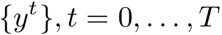
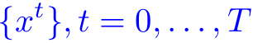


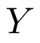
Deterministic (Logic) Causality
Definition:

Slide 5
Challenges in understanding Causality Relations in Economic System
Major conceptual challenges when inferring causality relations from large panels of economical data:
distinguishing between the signal and the noise in the data (since we are interested in causality for the signal - and not for the noise)
distinguishing between simple correlation and causality
multiscale nature of the spatial (e.g. regional, sectorial) and temporal (e.g. business and credit cycles) process evolution
influences of unresolved/latent scales and factors
Statistical approach: Model- or data-driven?
Parameter estimation and model specification errors

Slide 6
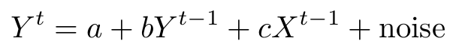
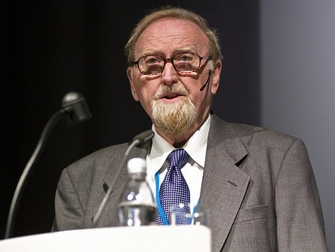
Standard Causality Inference: Granger Causality
Main idea:
Nobel Prize in Economics in 2003 to C. Granger and R. Engle:
“…in recognition that he and his co-winner, Robert F. Engle, had made contributions to the analysis of time series data that had changed fundamentally the way in which economists analyse financial and macroeconomic data.”
Figure from wikipedia.org
Granger, C. W. J. (1969). "Investigating causal relations by econometric models and cross-spectral methods". Econometrica 37 (3): 424–438
Sir Clive Granger
(1934-2009)

Slide 7
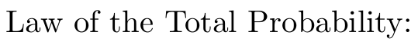
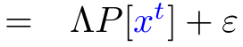
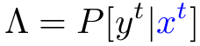
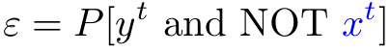
Probabilistic (Bayesian) Causality
Y
Notes:
No Model Error→Exact!→Joke with the dinosaur

Slide 8
Probabilistic (Bayesian) Causality
Gerber, S. and Horenko, I.: On Inference of Causality for Discrete State Models in a Multiscale Context, PNAS, 111(41), 14651-14656 (2014)

Slide 9
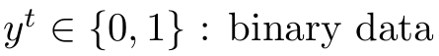
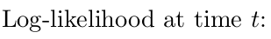
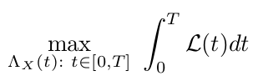
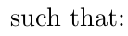
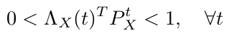
Statistical problem

Slide 10
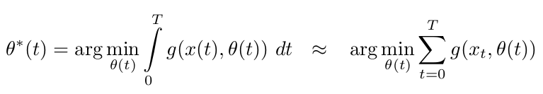
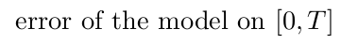
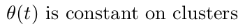
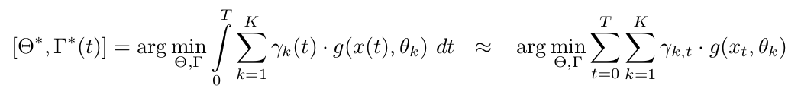
From nonstationary models to clustering
Assumption 1:
Horenko I.: Finite Element Approach to Clustering of Multidimensional Time Series, SIAM J. Sci. Comp. 32(1), 62-83 (2010)

Slide 11
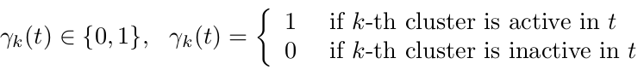
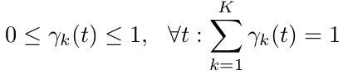
From nonstationary models to clustering
Assumption 2:
Horenko I.: Finite Element Approach to Clustering of Multidimensional Time Series, SIAM J. Sci. Comp. 32(1), 62-83 (2010)

Slide 12
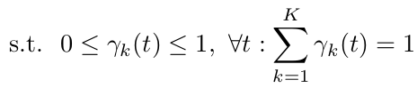
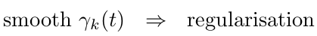
From nonstationary models to clustering
Assumption 3:
discretisation based on Finite Element Method
Horenko I.: Finite Element Approach to Clustering of Multidimensional Time Series, SIAM J. Sci. Comp. 32(1), 62-83 (2010)

Slide 13
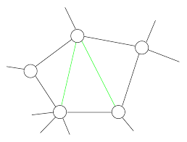
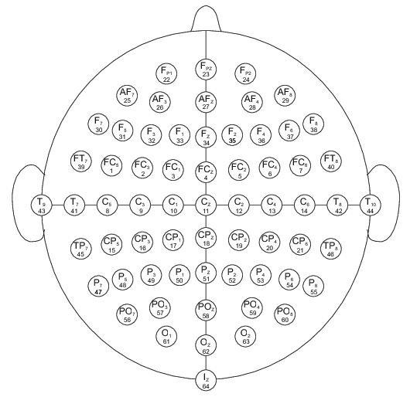

FEM-framework for de-noising and causality inference: from Time- to Graph-Regularisations
From time series data to general data on graphs and networks
→ graph-induced regularization
→ HPC-scalable QP-problems
graph-persistent/metastable models
time-persistent/metastable models
t
…
…
t_{n-2}
t_{n-1}
t_{n}
t_{n+1}
t_{n+2}
time
Regularization: parameter values of θ(t) should be similar if they are close in time
Regularization: parameter values of θ(s) should be similar if they are close on the graph
Gerber S., Horenko I.: Improving Clustering by Imposing Network Information, Sciences Advances (AAAS), 1(7):e1500163, 2015
Notes:
Note the difference with Bayesian learning
Straightforwadly generalizable for cases when θ and γ are functions of more then one argument
2. Nice link to graph-theory → not enough time → ask me later

Slide 14
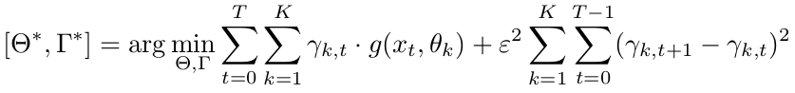
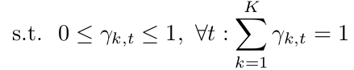
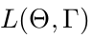
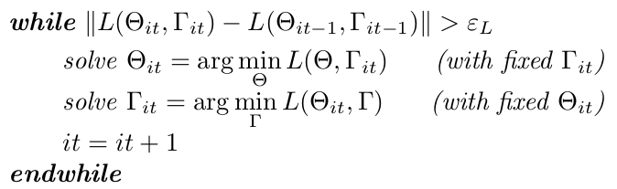
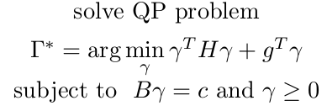
Solving the problem
depends on model

Slide 15
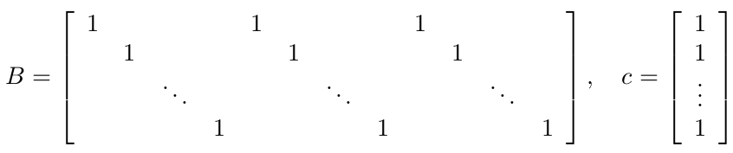
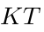
Solving the problem

Slide 16
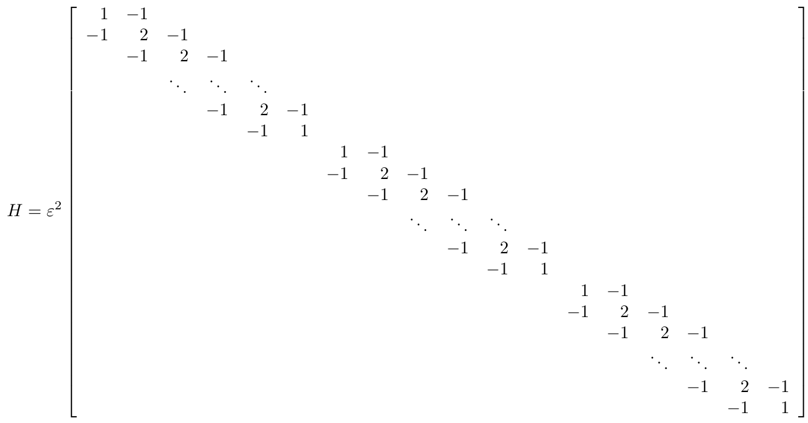
Solving the problem
suitable for matrix-free multiplication

Slide 17
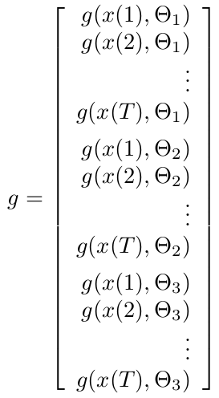
Solving the problem

Slide 18
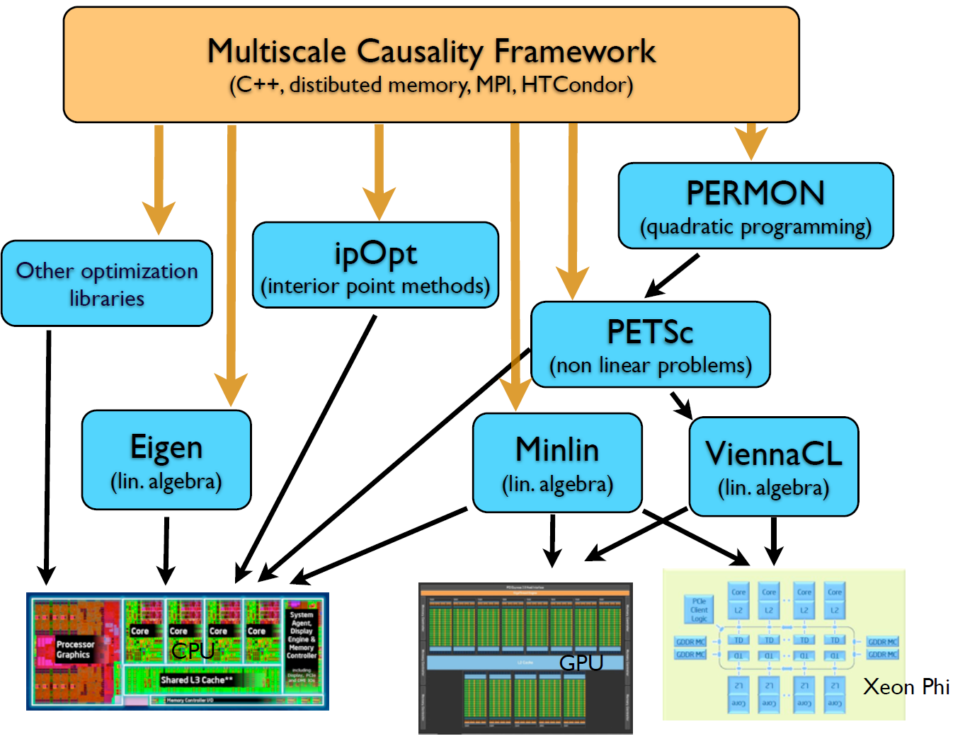
About the new library
a general layer on the top of existing open-source code (PETSc, MinLin, ...) to deal with data manipulations, outer loop management, Gamma/Theta problems assembly,...
uses multiple architectures (MPI, OpenMP, GPU) and multiple libraries (ipOpt, PERMON, ...)
in the end of the project will be published as open-source
https://github.com/eth-cscs/PASC_inference

Slide 19
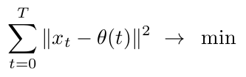
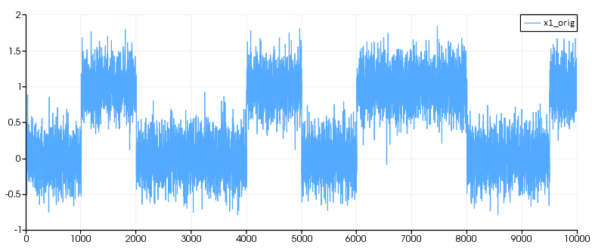
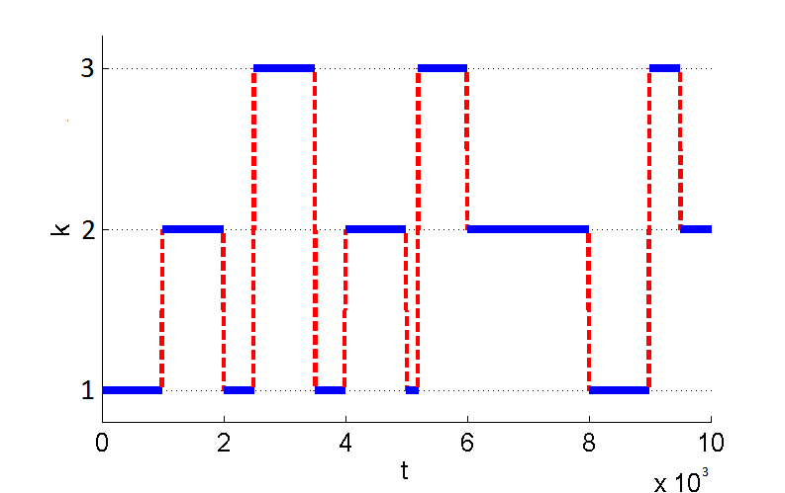
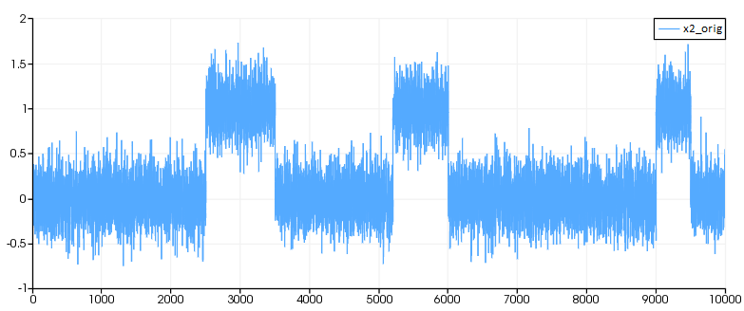
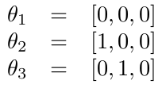
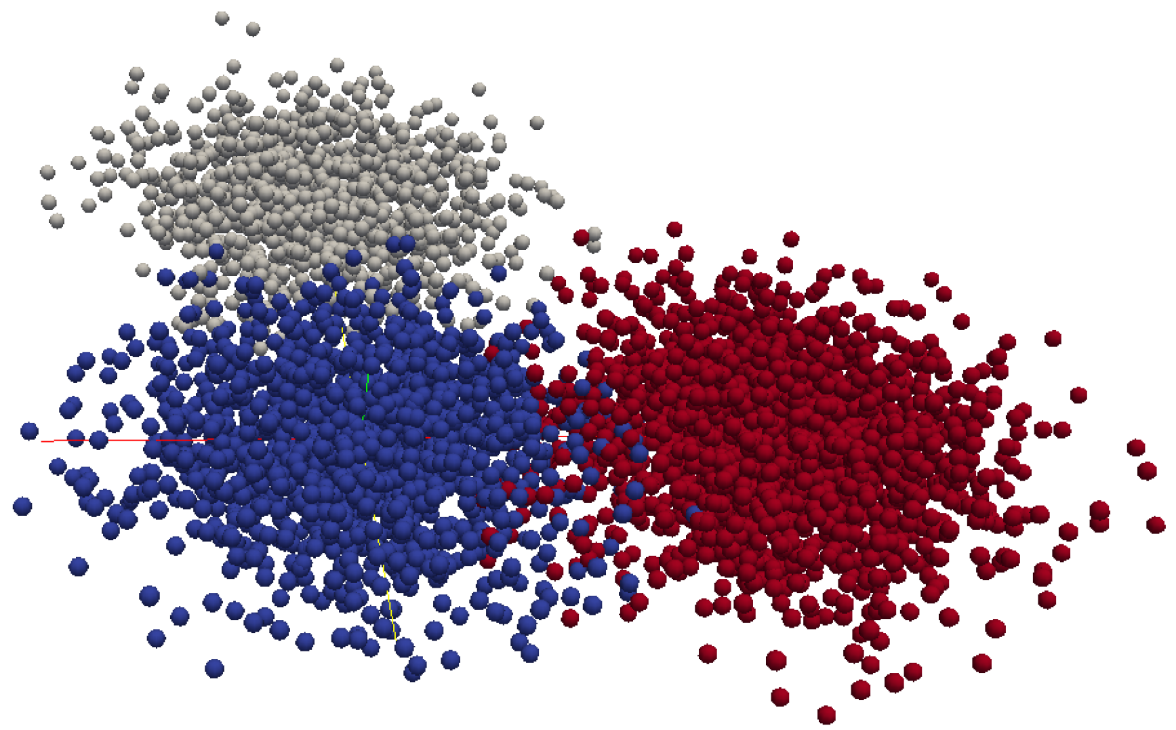
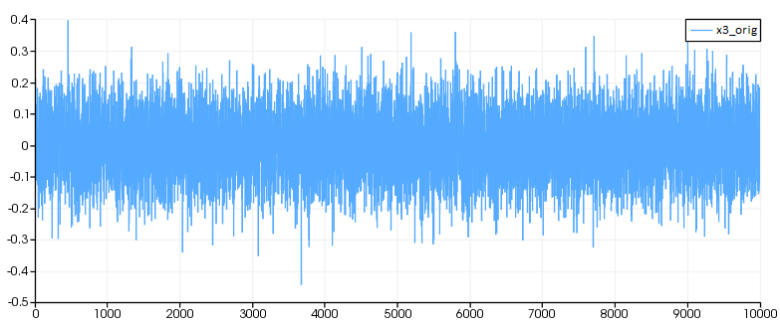
Preliminary results - "Kmeans" problem

Slide 20
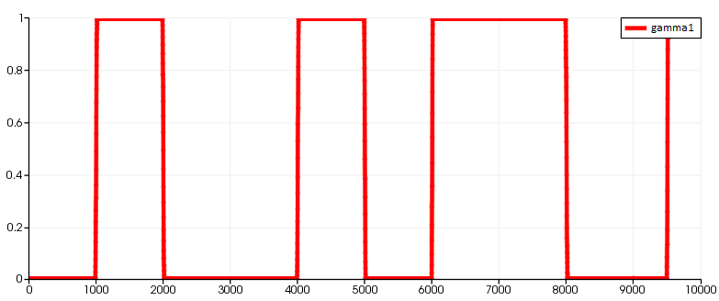
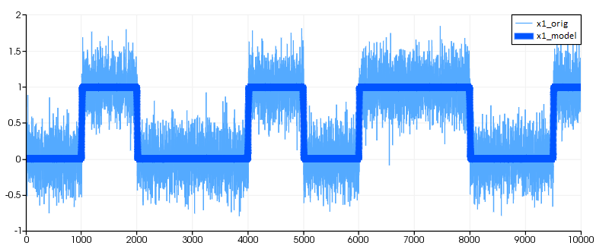
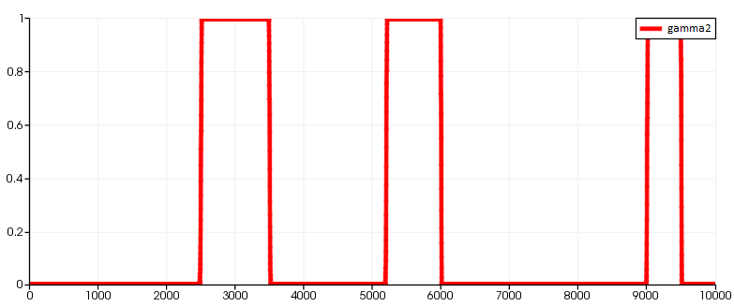
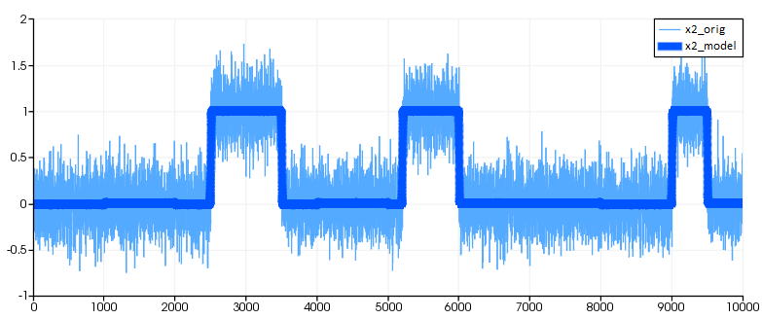
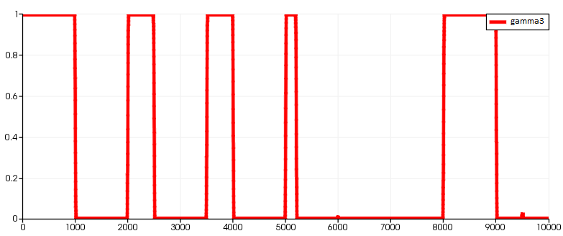
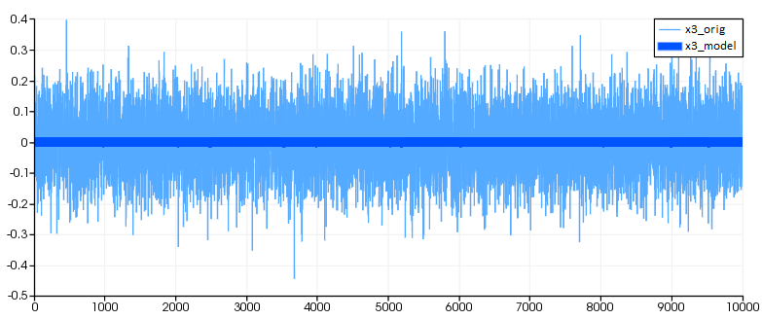
Preliminary results - "Kmeans" problem

Slide 21
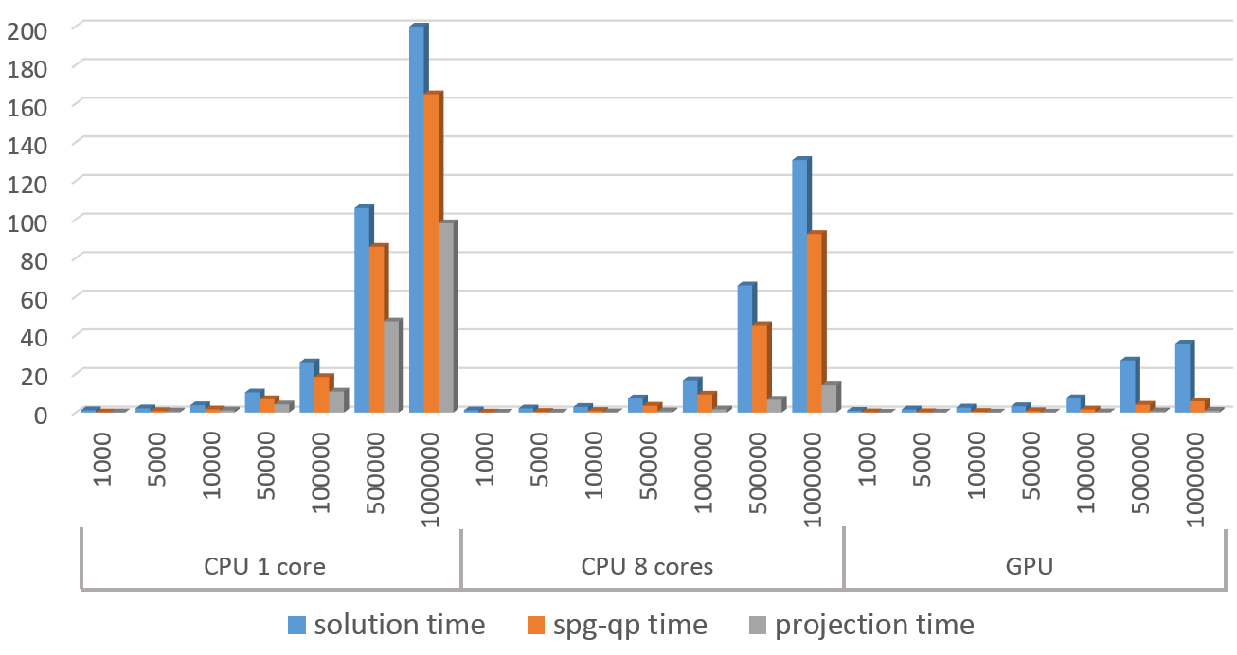
Preliminary results - "Kmeans" problem
computed on PIZ Daint machine (CSCS), one node
Intel Xeon E5-2670 (8 cores, 32GB) with NVIDIA Tesla K20X (2688 cores, 6GB)

Slide 22
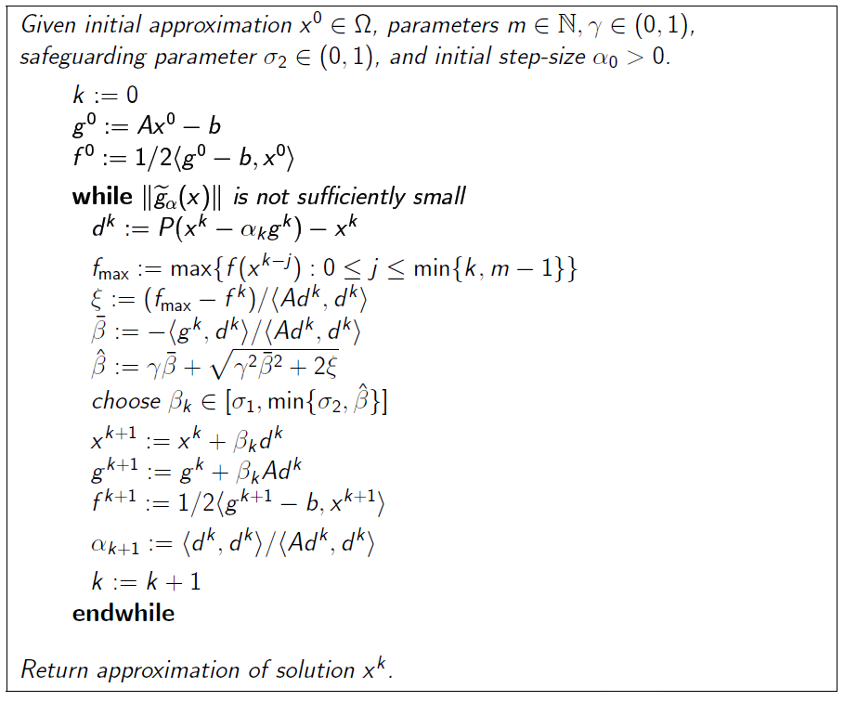


Spectral Projected Gradient method for QP
Birgin E.G., Martínez J.M., Raydan M.: Nonmonotone spectral projected gradient methods on convex sets, (2000)
Birgin E.G., Raydan M., Martínez J.M.: Spectral Projected Gradient Methods: Review and Perspectives, (2014)
Pospíšil L.: Development of Algorithms for Solving Minimizing Problems with Convex Quadratic Function on Special Convex Sets and Applications, PhD thesis, supervised by Z. Dostál (2015)

Slide 23


Feasible set - separable simplexes
T separable simplexes (hypertriangles) = fully parallel projection

Slide 24

Thank you for your attention!
https://github.com/eth-cscs/PASC_inference
We would like to express our thanks to "Platform for Advanced Scientific Computing (PASC)" for financing our exploratory project "Towards the HPC-inference of causality networks from multiscale economical data".
Horenko I., Gagliardini P., Sawyer W., Pospisil L.: Towards the HPC-inference of causality networks from multiscale economical data, PASC 16, Lausanne, poster

